Slide 1

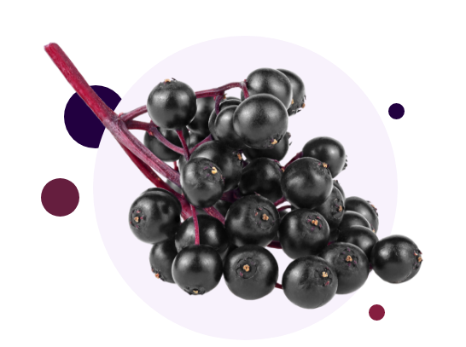
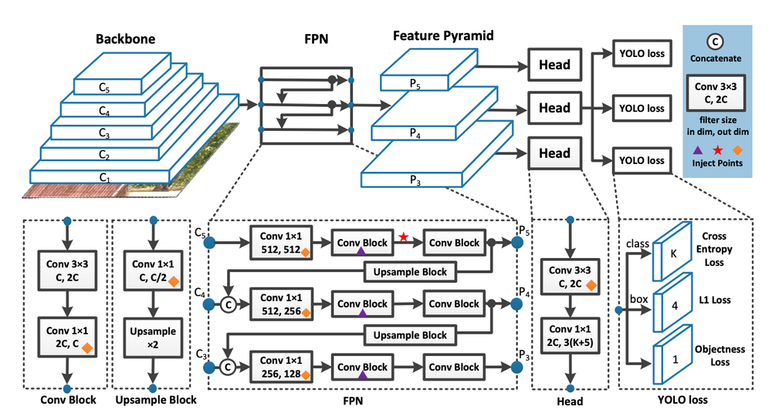
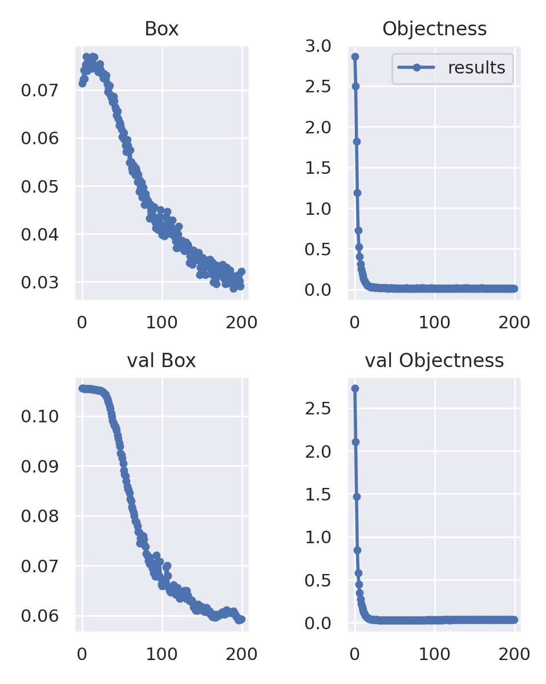
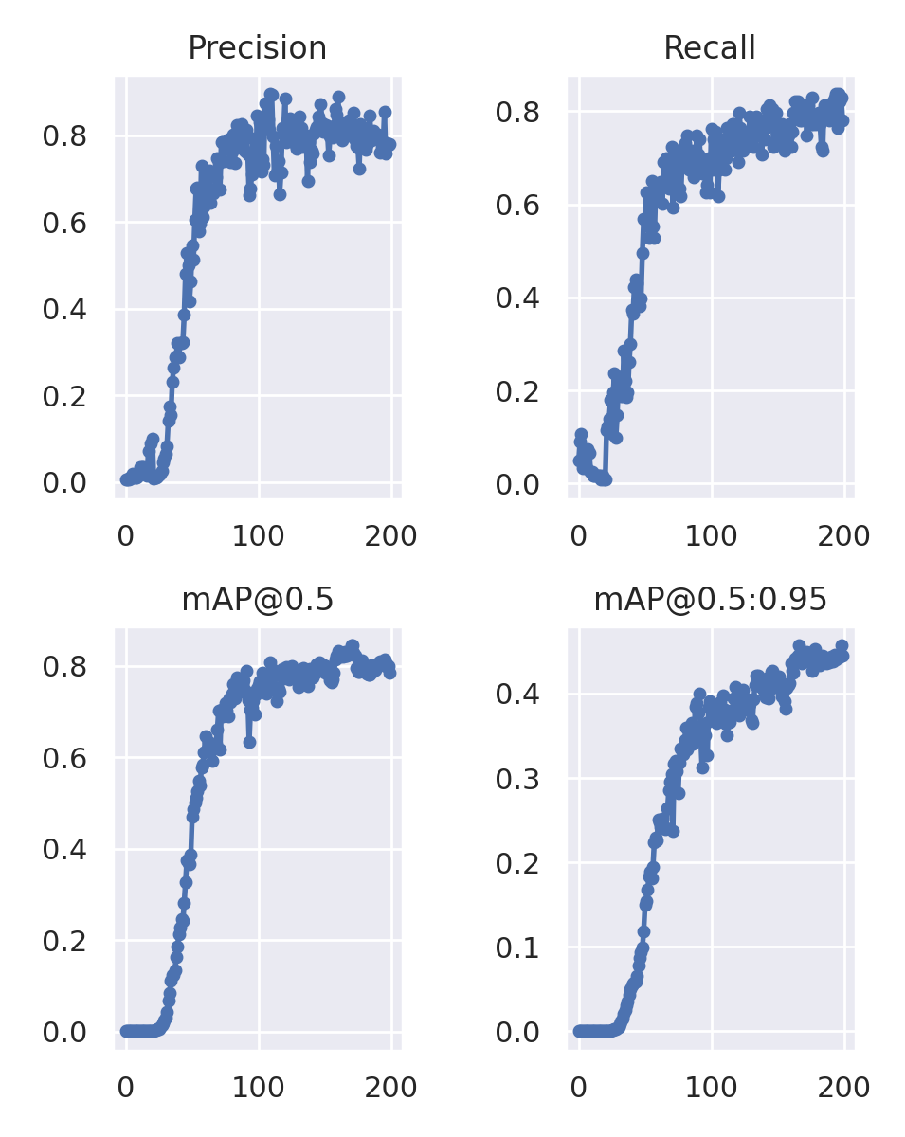
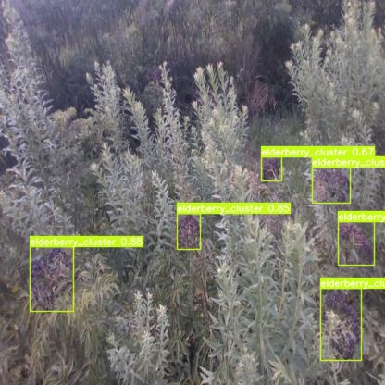
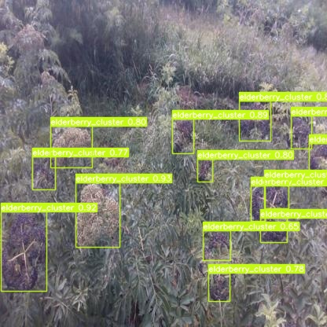
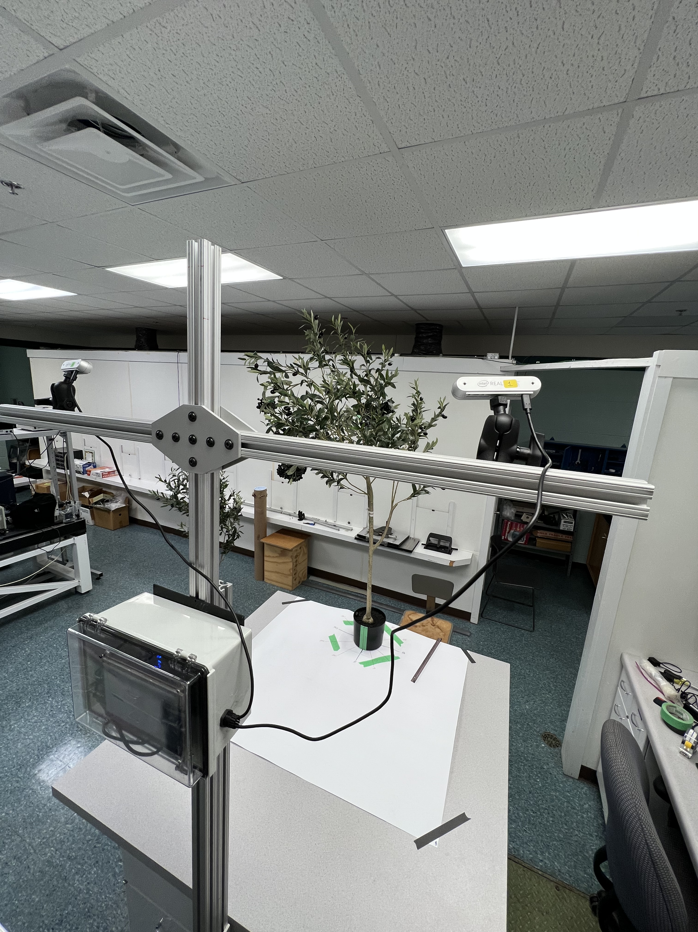
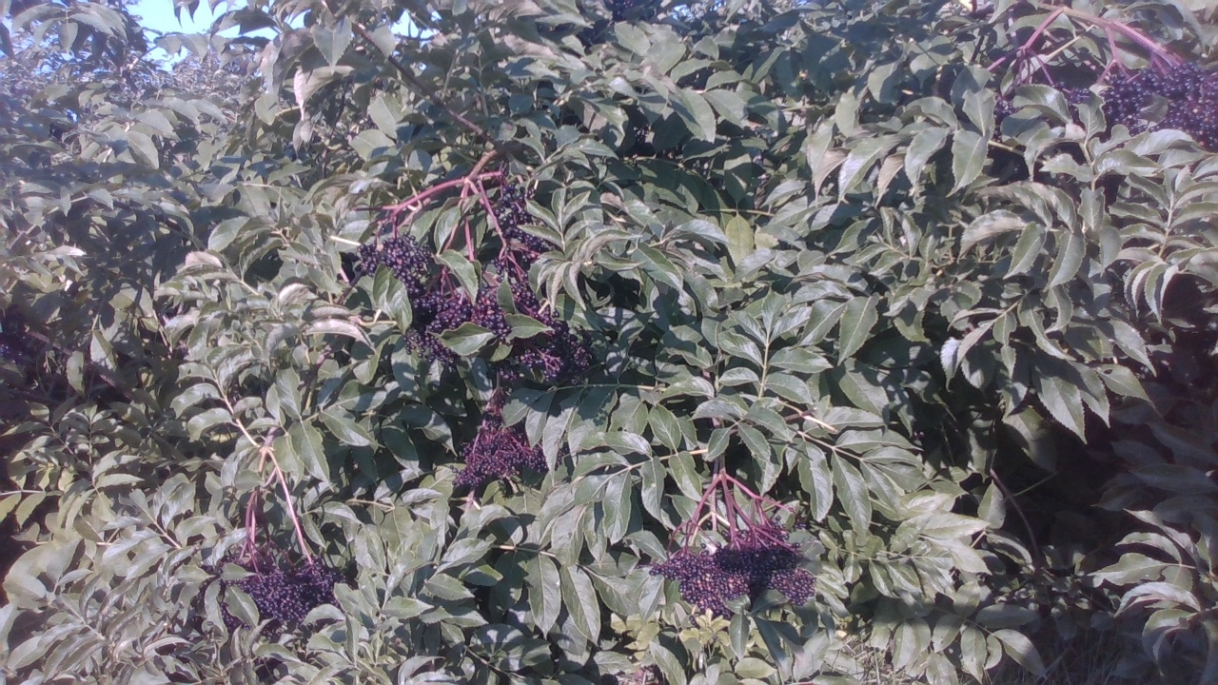
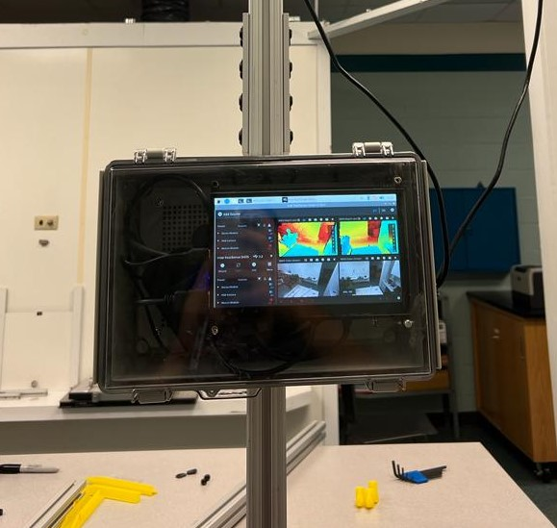
Robotic Harvest for Elderberry – Machine Vision
Jianfeng Zhou, Gian Lucca Teixeira
University of Missouri, Columbia, MO (contact: gat7hb@umsystem.edu)
Introduction
Object Detection on Elderberry
American Elderberry:
High-value crop in the state of Missouri, still great potential for improvement.
Issues in its harvesting and processing system.
Selective harvesting mechanism could be developed in order to give more profitability for the elderberry crop.
Solution:
Selective harvesting solution requires a system that will determine whether the crop is ripped or not.
Camera system alongside deep learning algorithms would be appropriate in order to perceive the environment to detect elderberries and classify their ripeness.
YOLOv7 model:
State of Art in single-stage object detector.
Model is able to predict with real-time speed.
Extracted 104 RGB images from the elderberry dataset and labeled all clusters manually.
Trained YOLOv7 with 104 .jpg images with size 640x640.
Able to detect with an intersection over union (IoU) of 83%
YOLOv7 architecture
Elderberry Detection Results
Best mAP@.5: 84% (Confidence level of 50%)
Best mAP@.95: 45% (Confidence level of 95%)
Best Precision: 89%
Best Recall: 83%
Best box loss: 3%
Best object loss: 1.5%
Data Collection Method
In order to use deep learning algorithms to perceive the elderberries, it was necessary to collect multiple images of elderberry clusters:
The camera used to collect the data was the Intel RealSense Stereo camera D435i which can acquire RGB information as well as depth information for 3D reconstruction of the environment.
Model inference with confidence levels
Model inference with confidence levels
A Raspberry Pi 4 was used to control the camera and to collect .BAG file format in order to record all the data captured by the D435i as well as its metadata.
Data collected from 08/08/2022 to 08/26/2022, in total collected 1,788 .BAG frames were captured by the data collection system plus 200 RGB pictures captured from cellphones and Sony cameras.
Ground Truth:
100 Images collected with color stand for ripeness color reference, plus 60 images of manually accessed ripped clusters.
15 on field + 216 in lab manually measured depth and XYZ location with the camera as the reference frame.
Summary and Future Work
Summary
Developed a camera system for the perception and detection of elderberries.
Created an elderberry dataset with around 2000 frames.
Results over 83% of mean accuracy precision.
RGB frame captured by the data collection system
Raspberry Pi 4 control box running Intel’s SDK to control the cameras
Data collection system (Intel RealSense connected to Raspberry Pi 4 inside of the control box)
Future work
Continue to label elderberry dataset in order to improve detection rate.
Run classification CNN model to classify the state of ripeness.

